Slide 1
Operating Systems (First Semester- 2022)
Lecture 1 - Introduction and Overview
Dr. Bright S.K. Anibrika
[lecture slides contains some content adapted from : Silberschatz textbook authors, John Kubiatowicz (Berkeley)
Anderson textbook, John Ousterhout(Stanford), Prof. Ardalan Sani, )
]
Principles of Operating Systems - Lecture 1
1

Slide 2
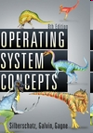
Course logistics and details
ICS 143 Textbook
Operating System Concepts – 9th Edition, Silberschatz, Galvin and Gagne, Addison-Wesley Inc (Eighth, Seventh,Sixth and Fifth editions, and Java Versions are fine ).
Other Suggested Books
Modern Operating Systems, by Tanenbaum
Lubomir Bic, online book -- zybooks
https://www.zybooks.com/catalog/operating-systems/
Operating Systems: Principles and Practice, by T. Anderson and M. Dahlin (second edition)

Slide 3
Course logistics and details
Homeworks and Assignments
4 written homeworks in the quarter
1 programming assignment (knowledge of C, C++ or Java required).
Handed out at midterm; submit during Finals Week
Multistep assignment – don’t start in last week of classes!!!
Late homeworks will not be accepted.
All submissions will be made using Gradescope for the course
Tests
Midterm/ IA - Week 6
Principles of Operating Systems - Lecture 1
3

Slide 4
Lecture Schedule
Week 1:
Introduction to Operating Systems, Computer System Structures, Operating System Structures
Week 2 : Process Management
Processes and Threads, CPU Scheduling
Week 3: Process Management
CPU Scheduling, Process Synchronization
Week 4: Process Management
Process Synchronization
Week 5: Process Management
Process Synchronization, Deadlocks
Principles of Operating Systems - Lecture 1
4

Slide 5
Course Schedule
Week 6 – Deadlocks, Storage Management
Deadlocks, Midterm revision, exam
Week 7 - Storage Management
Memory Management, Paging, Segmentation
Week 8 – Storage Management
Virtual Memory
Week 9 - FileSystems
Virtual Memory, FileSystems Interface and Implementation
Week 10 – I/O Subsystems
Filesystems, I/O, course revision and summary.
Principles of Operating Systems - Lecture 1
5

Slide 6
Introduction
What is an operating system?
Operating Systems History
Simple Batch Systems
Multiprogrammed Batch Systems
Time-sharing Systems
Personal Computer Systems
Parallel and Distributed Systems
Real-time Systems
Principles of Operating Systems - Lecture 1
6

Slide 7
What is an Operating System?
An OS is a program that acts an intermediary between the user of a computer and computer hardware.
Major cost of general purpose computing is software.
OS simplifies and manages the complexity of running application programs efficiently.
Principles of Operating Systems - Lecture 1
7

Slide 8
Computer System Components
Hardware
Provides basic computing resources (CPU, memory, I/O devices).
Operating System
Controls and coordinates the use of hardware among application programs.
Application Programs
Solve computing problems of users (compilers, database systems, video games, business programs such as banking software).
Users
People, machines, other computers
Principles of Operating Systems - Lecture 1
8

Slide 9
Abstract View of System
User
1
User
2
User
3
User
n
...
System and Application Programs
compiler
assembler
Text editor
Database
system
Operating System
Computer
Hardware
Principles of Operating Systems - Lecture 1
9

Slide 10
Operating System Views
Resource allocator
to allocate resources (software and hardware) of the computer system and manage them efficiently.
Control program
Controls execution of user programs and operation of I/O devices.
Kernel
The program that executes forever (everything else is an application with respect to the kernel).
Principles of Operating Systems - Lecture 1
10

Slide 11
Operating system roles
Referee
Resource allocation among users, applications
Isolation of different users, applications from each other
Communication between users, applications
Illusionist
Each application appears to have the entire machine to itself
Infinite number of processors, (near) infinite amount of memory, reliable storage, reliable network transport
Glue
Libraries, user interface widgets, …
Reduces cost of developing software
11

Slide 12
Example: file systems
Referee
Prevent users from accessing each other’s files without permission
Illusionist
Files can grow (nearly) arbitrarily large
Files persist even when the machine crashes in the middle of a save
Glue
Named directories, printf, …
12

Slide 13
Goals of an Operating System
Simplify the execution of user programs and make solving user problems easier.
Use computer hardware efficiently.
Allow sharing of hardware and software resources.
Make application software portable and versatile.
Provide isolation, security and protection among user programs.
Improve overall system reliability
error confinement, fault tolerance, reconfiguration.
Principles of Operating Systems - Lecture 1
13

Slide 14
Why should I study Operating Systems?
Need to understand interaction between the hardware and applications
New applications, new hardware..
Inherent aspect of society today
Need to understand basic principles in the design of computer systems
efficient resource management, security, flexibility
Increasing need for specialized operating systems
e.g. embedded operating systems for devices - cell phones, sensors and controllers
real-time operating systems - aircraft control, multimedia services
Principles of Operating Systems - Lecture 1
14

Slide 15
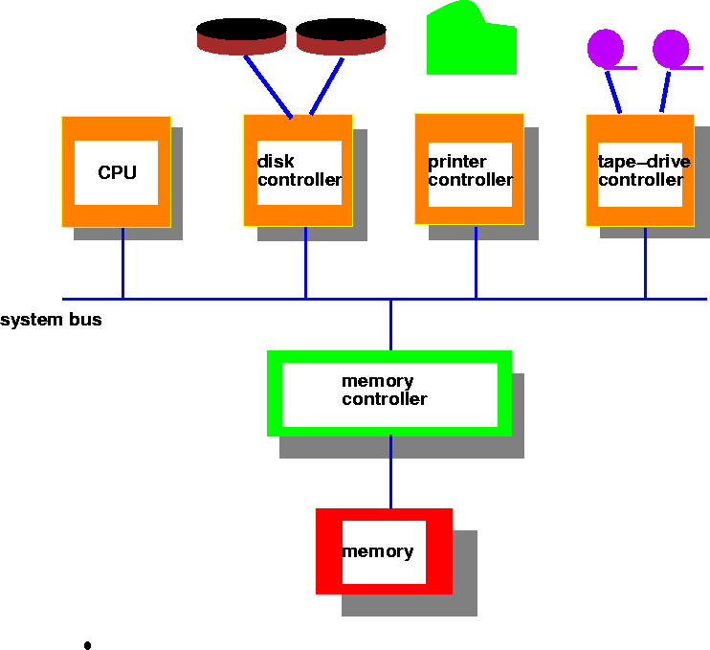
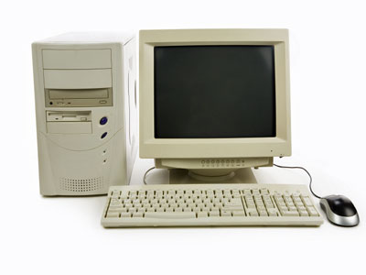
Computer System Architecture (traditional)

Slide 16
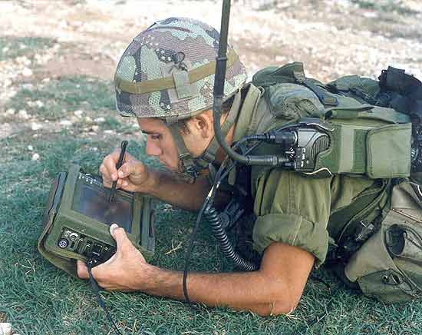
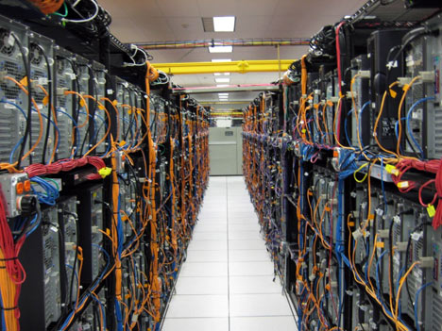
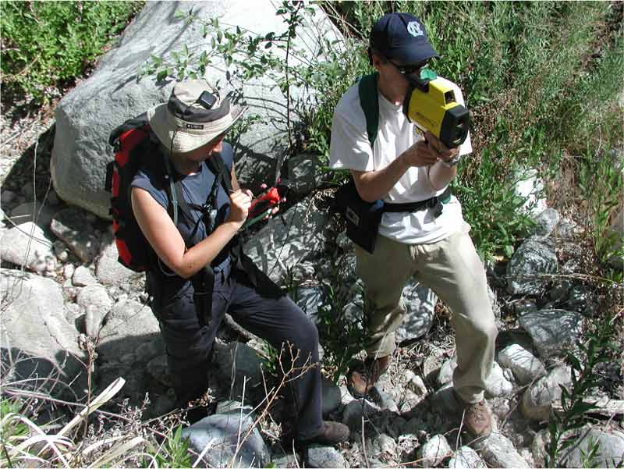
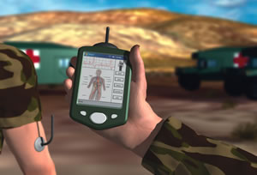
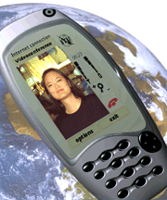
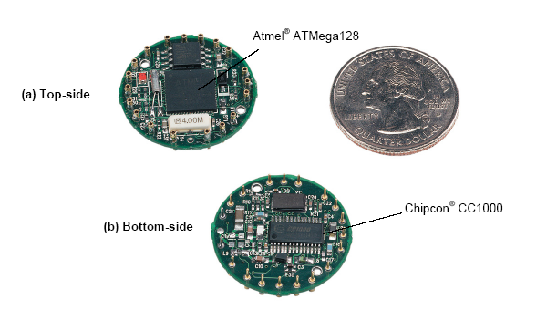
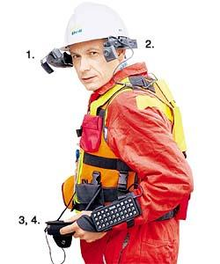
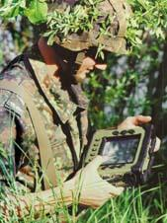

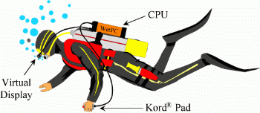
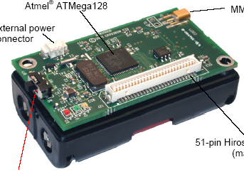
Systems Today
Principles of Operating Systems - Lecture 1
16

Slide 17
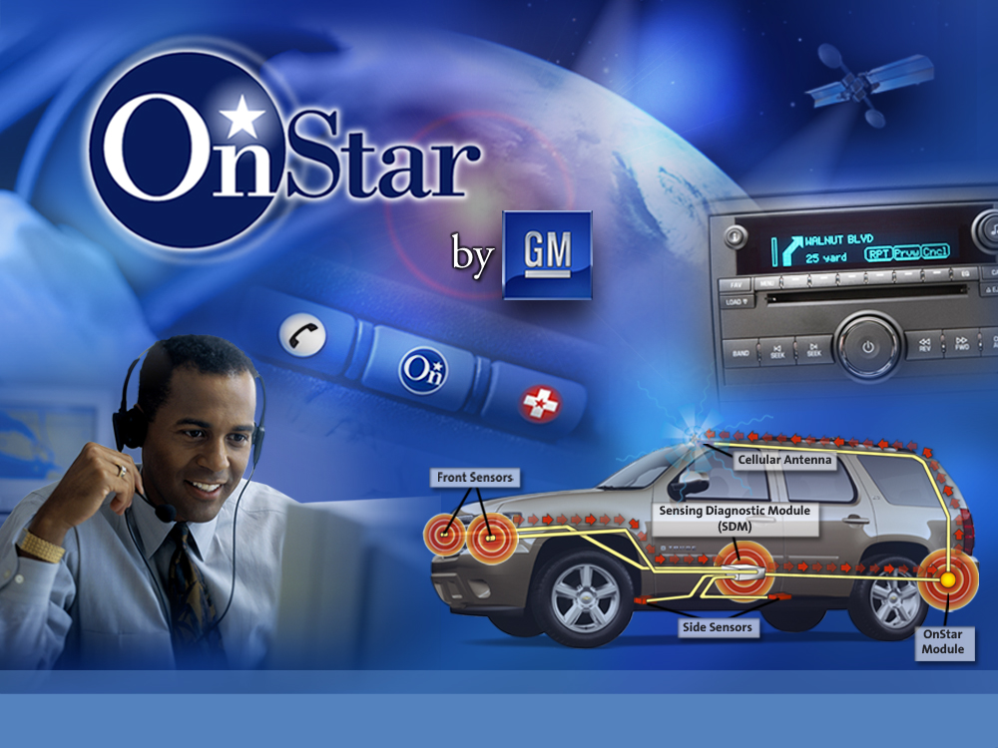
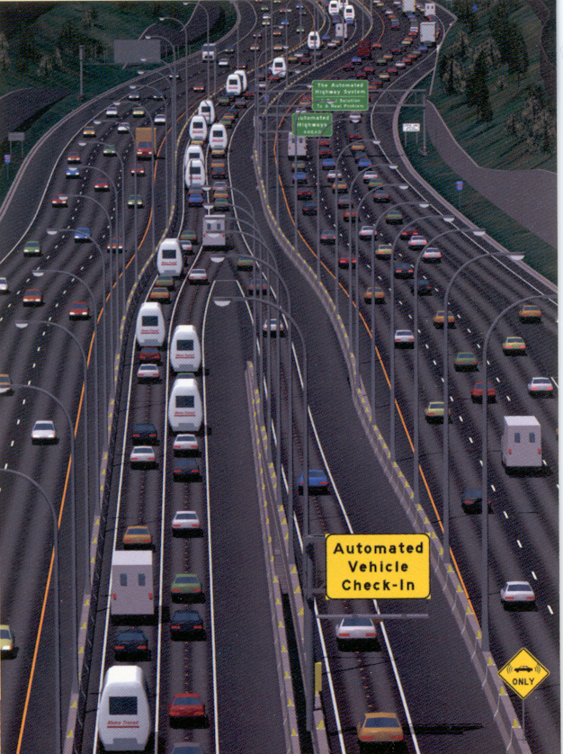
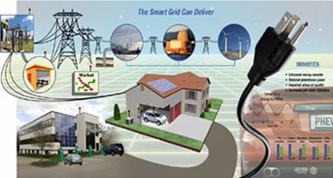
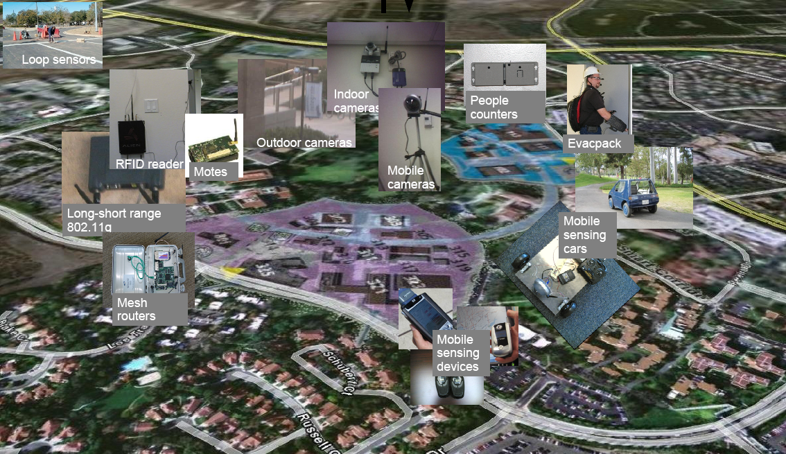
Irvine Sensorium
Notes:
17

Slide 18
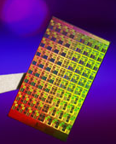
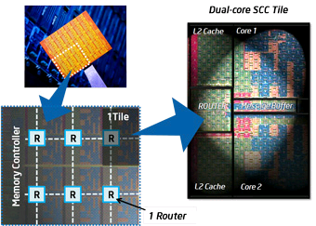
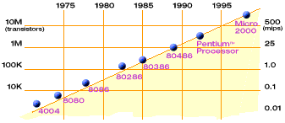
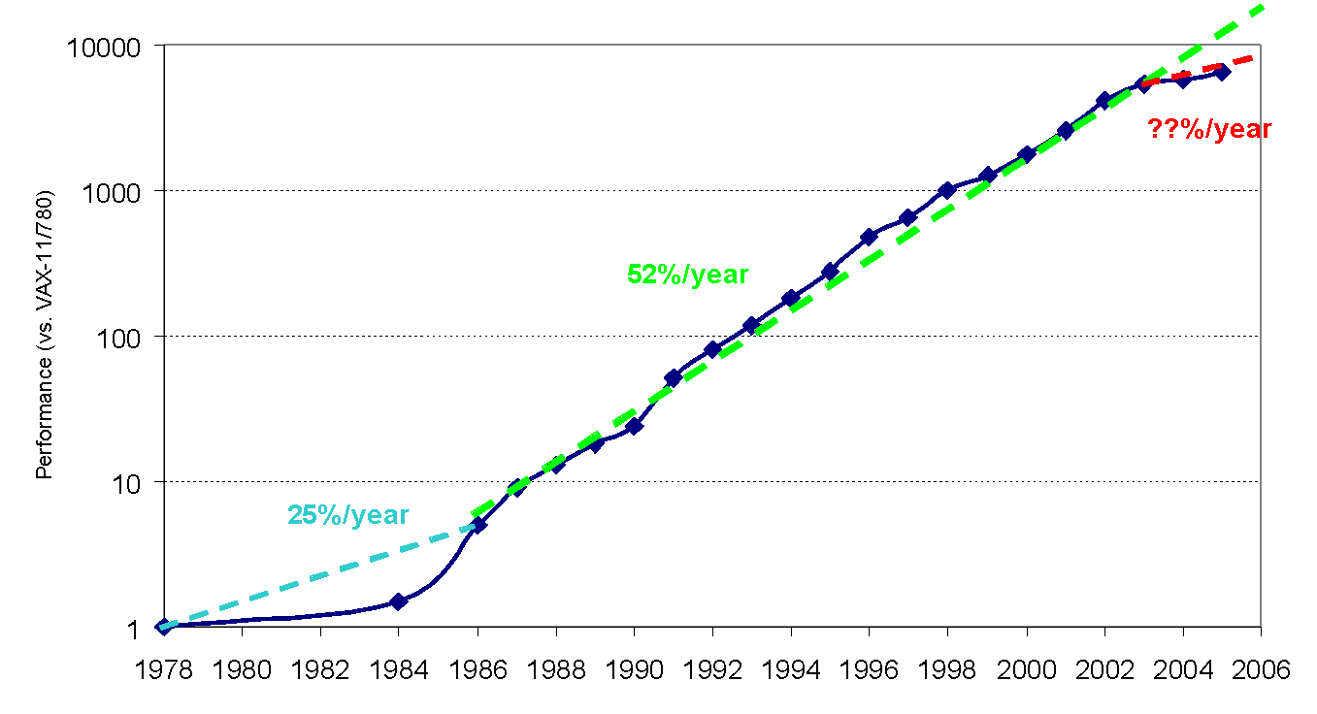
Hardware Complexity Increases
Moore’s Law: 2X transistors/Chip Every 1.5 years
From Berkeley OS course
Intel Multicore Chipsets
Moore’s Law
Principles of Operating Systems - Lecture 1
18
From Hennessy and Patterson, Computer Architecture: A Quantitative Approach, 4th edition, Sept. 15, 2006

Slide 19
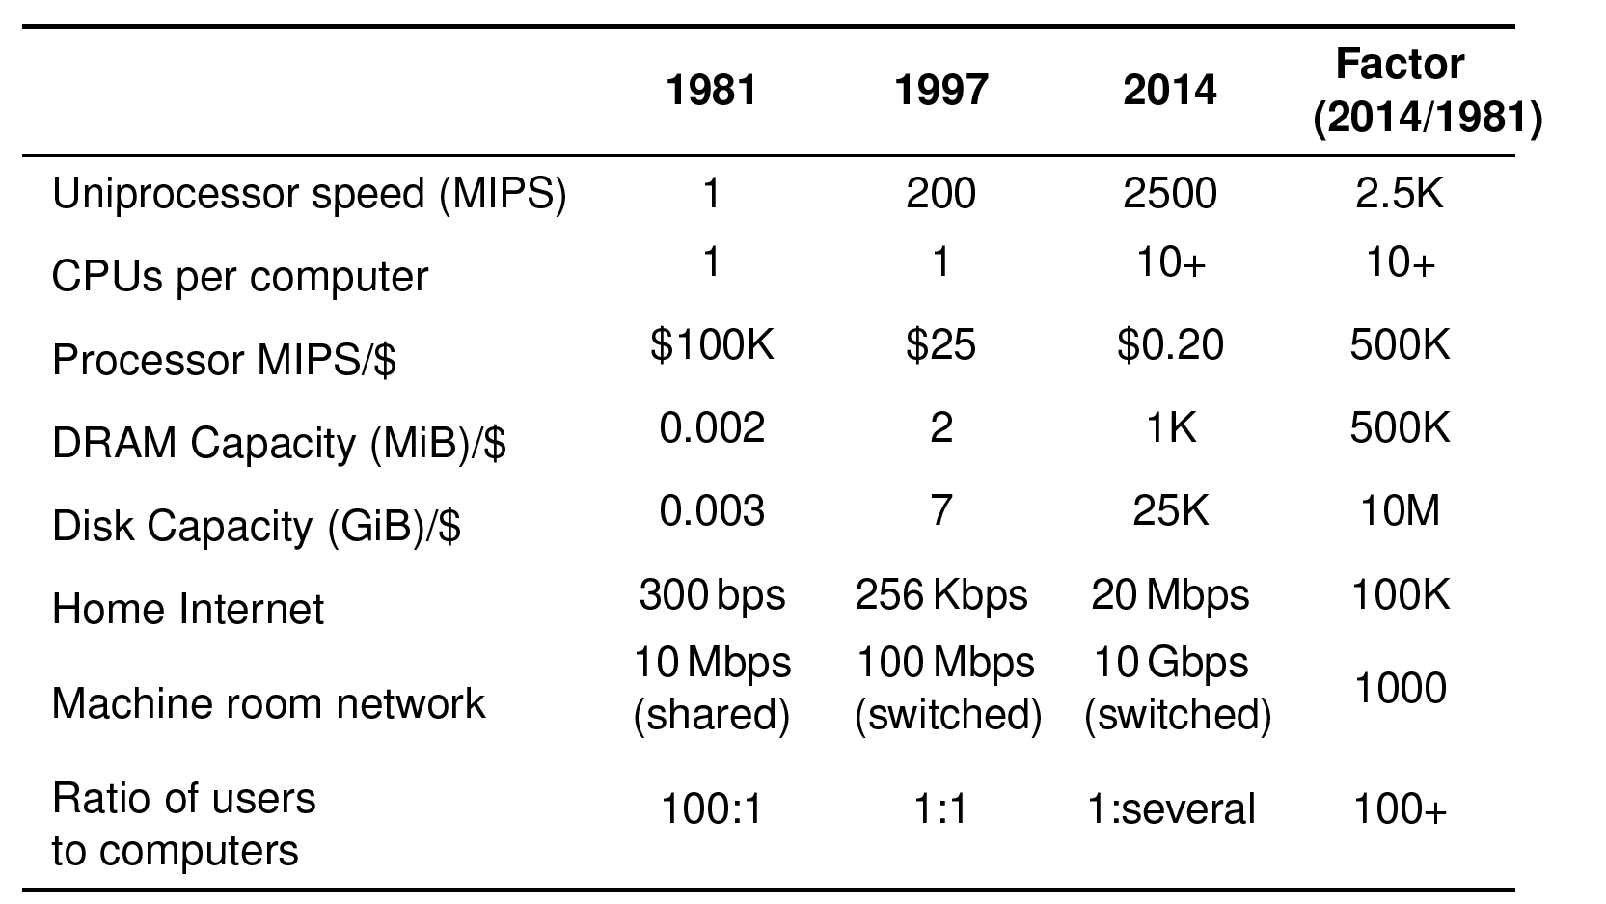
OS needs to keep pace with hardware improvements
$/
19

Slide 20
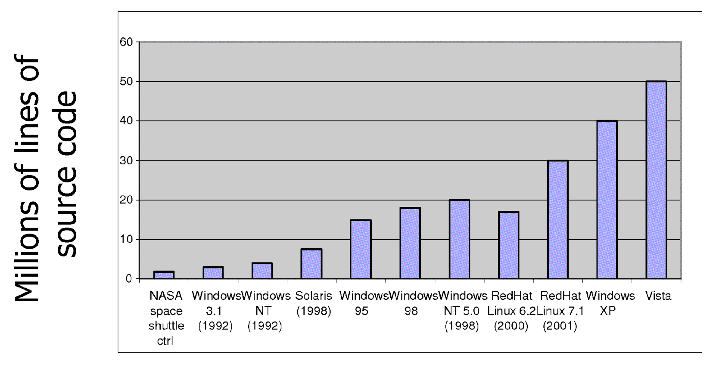
Software Complexity Increases
From MIT’s 6.033 course
Principles of Operating Systems - Lecture 1
20

Slide 21
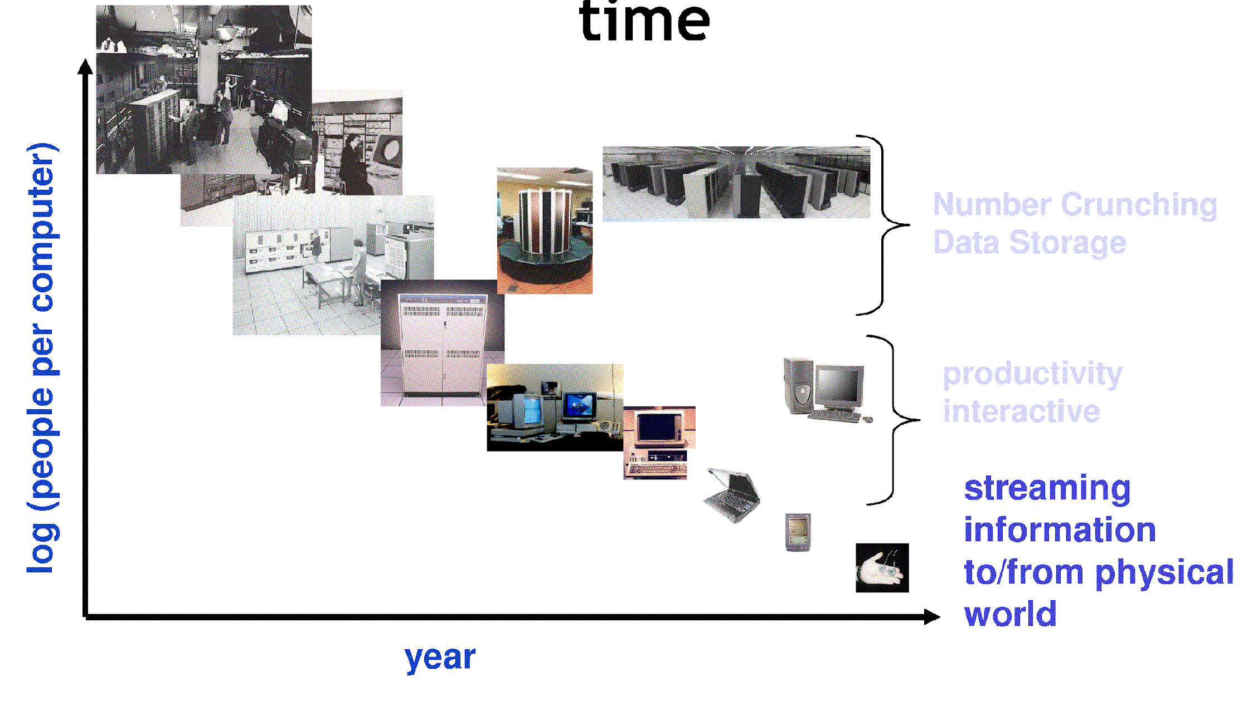
People-to-Computer Ratio Over Time
From David Culler (Berkeley)

Slide 22
Operating System Spectrum
Monitors and Small Kernels
special purpose and embedded systems, real-time systems
Batch and multiprogramming
Timesharing
workstations, servers, minicomputers, timeframes
Transaction systems
Personal Computing Systems
Mobile Platforms, devices (of all sizes)
Principles of Operating Systems - Lecture 1
22

Slide 23
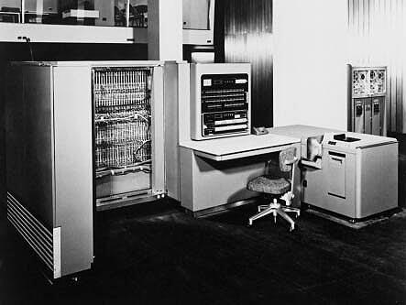
Early Systems - Bare Machine (1950s)
Structure
Large machines run from console
Single user system
Programmer/User as operator
Paper tape or punched cards
Early software
Assemblers, compilers, linkers, loaders, device drivers, libraries of common subroutines.
Secure execution
Inefficient use of expensive resources
Low CPU utilization, high setup time.
Hardware – expensive ; Human – cheap
From John Ousterhout slides
Principles of Operating Systems - Lecture 1
23

Slide 24
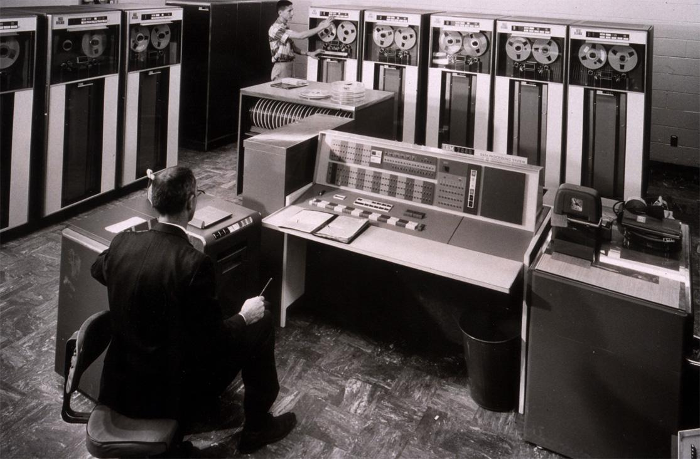
Simple Batch Systems (1960’s)
Reduce setup time by batching jobs with similar requirements.
Add a card reader, Hire an operator
User is NOT the operator
Automatic job sequencing
Forms a rudimentary OS.
Resident Monitor
Holds initial control, control transfers to job and then back to monitor.
Problem
Need to distinguish job from job and data from program.
From John Ousterhout slides
Principles of Operating Systems - Lecture 1
24

Slide 25
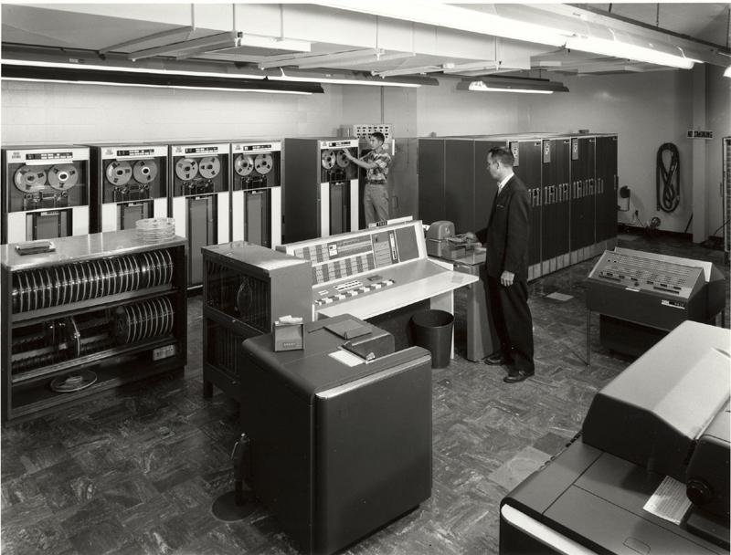
Supervisor/Operator Control
Secure monitor that controls job processing
Special cards indicate what to do.
User program prevented from performing I/O
Separate user from computer
User submits card deck
cards put on tape
tape processed by operator
output written to tape
tape printed on printer
Problems
Long turnaround time - up to 2 DAYS!!!
Low CPU utilization
I/O and CPU could not overlap; slow mechanical devices.
IBM 7094
From John Ousterhout slides
Principles of Operating Systems - Lecture 1
25

Slide 26
Batch Systems - Issues
Solutions to speed up I/O:
Offline Processing
load jobs into memory from tapes, card reading and line printing are done offline.
Spooling
Use disk (random access device) as large storage for reading as many input files as possible and storing output files until output devices are ready to accept them.
Allows overlap - I/O of one job with computation of another.
Introduces notion of a job pool that allows OS choose next job to run so as to increase CPU utilization.
Principles of Operating Systems - Lecture 1
26

Slide 27
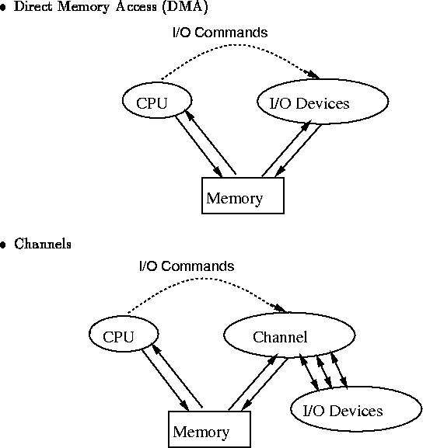
Speeding up I/O
Principles of Operating Systems - Lecture 1
27

Slide 28
Batch Systems - I/O completion
How do we know that I/O is complete?
Polling:
Device sets a flag when it is busy.
Program tests the flag in a loop waiting for completion of I/O.
Interrupts:
On completion of I/O, device forces CPU to jump to a specific instruction address that contains the interrupt service routine.
After the interrupt has been processed, CPU returns to code it was executing prior to servicing the interrupt.
Principles of Operating Systems - Lecture 1
28

Slide 29
Multiprogramming
Use interrupts to run multiple programs simultaneously
When a program performs I/O, instead of polling, execute another program till interrupt is received.
Requires secure memory, I/O for each program.
Requires intervention if program loops indefinitely.
Requires CPU scheduling to choose the next job to run.
Principles of Operating Systems - Lecture 1
29

Slide 30
Timesharing
Programs queued for execution in FIFO order.
Like multiprogramming, but timer device interrupts after a quantum (timeslice).
Interrupted program is returned to end of FIFO
Next program is taken from head of FIFO
Control card interpreter replaced by command language interpreter.
Hardware – getting cheaper; Human – getting expensive
Principles of Operating Systems - Lecture 1
30

Slide 31
Timesharing (cont.)
Interactive (action/response)
when OS finishes execution of one command, it seeks the next control statement from user.
File systems
online filesystem is required for users to access data and code.
Virtual memory
Job is swapped in and out of memory to disk.
Principles of Operating Systems - Lecture 1
31

Slide 32
Personal Computing Systems
Single user systems, portable.
I/O devices - keyboards, mice, display screens, small printers.
Laptops and palmtops, Smart cards, Wireless devices.
Single user systems may not need advanced CPU utilization or protection features.
Advantages:
user convenience, responsiveness, ubiquitous
Hardware – cheap ; Human – expensive
Principles of Operating Systems - Lecture 1
32

Slide 33
Parallel Systems
Multiprocessor systems with more than one CPU in close communication.
Improved Throughput, economical, increased reliability.
Kinds:
Vector and pipelined
Symmetric and asymmetric multiprocessing
Distributed memory vs. shared memory
Programming models:
Tightly coupled vs. loosely coupled ,message-based vs. shared variable
Principles of Operating Systems - Lecture 1
33

Slide 34
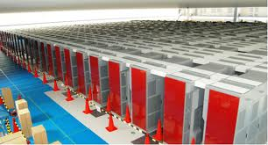
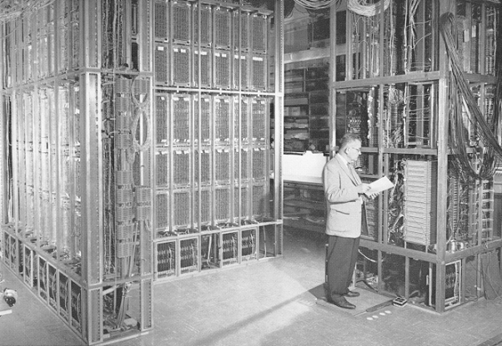
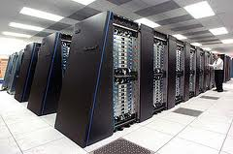
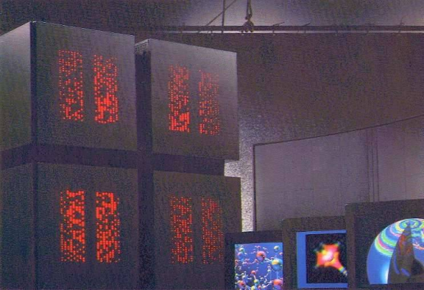
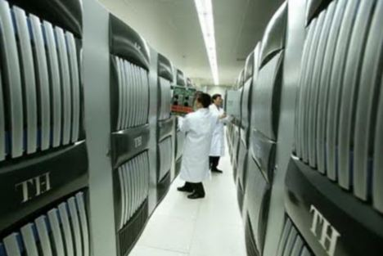
Parallel Computing Systems
ILLIAC 2 (UIllinois)
Climate modeling, earthquake simulations, genome analysis, protein folding, nuclear fusion research, …..
K-computer(Japan)
Tianhe-1(China)
IBM Blue Gene
Connection Machine (MIT)
Principles of Operating Systems - Lecture 1
34

Slide 35
Distributed Systems
Distribute computation among many processors.
Loosely coupled -
no shared memory, various communication lines
client/server architectures
Advantages:
resource sharing
computation speed-up
reliability
communication - e.g. email
Applications - digital libraries, digital multimedia
Hardware – very cheap ; Human – very expensive
Principles of Operating Systems - Lecture 1
35

Slide 36
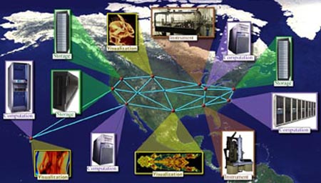
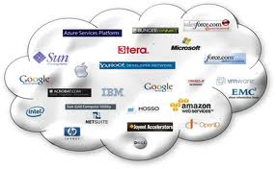
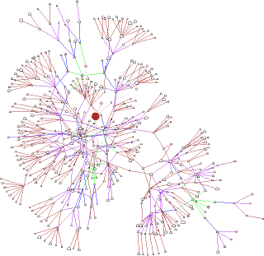
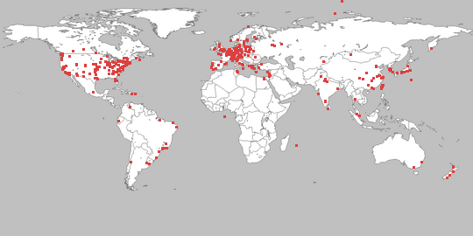
Distributed Computing Systems
Globus Grid Computing Toolkit
Cloud Computing Offerings
PlanetLab
Principles of Operating Systems - Lecture 1
Gnutella P2P Network
36

Slide 37


Real-time systems
Correct system function depends on timeliness
Feedback/control loops
Sensors and actuators
Hard real-time systems -
Failure if response time too long.
Secondary storage is limited
Soft real-time systems -
Less accurate if response time is too long.
Useful in applications such as multimedia, virtual reality.
Principles of Operating Systems - Lecture 1
37

Slide 38
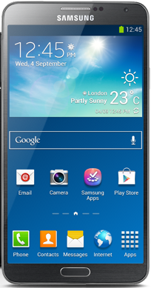

A personal computer today
64 GB internal storage (extended by microSD)
4G LTE
S pen
Super AMOLED display (1080 x 1920 pixels, 5.7 inches (~386 ppi pixel density))
capacitive touchscreen, 16M colors, multitouch
speaker, mic, audio jack
vibration
NFC
WiFi
bluetooth
Infrared
13 MP front camera
2 MP back camera
Adreno 330 GPU
Accelerometer
gyro
proximity sensor
compass
barometer
temperature sensor
humidity sensor
gesture sensor
GPS
Hexagon DSP
Audio/Video HW accelerator
Multimedia processor
interaction
Super AMOLED display
Capacitive touchscreen (multitouch)
Audio (speaker, microphone)
Vibration
S pen
4G LTE
NFC
WiFi
Bluetooth
Infrared
64 GB internal storage (extended by microSD)
Adreno 330 GPU
Hexagon DSP
Multimedia processor
13 MP front camera
2 MP back camera
Accelerometer
Gyroscope
Proximity sensor
Compass
Barometer
Temperature sensor
Humidity sensor
Gesture Sensor
GPS
38

Slide 39
A personal computer today
64 GB internal storage (extended by microSD)
4G LTE
S pen
Super AMOLED display (1080 x 1920 pixels, 5.7 inches (~386 ppi pixel density))
capacitive touchscreen, 16M colors, multitouch
speaker, mic, audio jack
vibration
NFC
WiFi
bluetooth
Infrared
13 MP front camera
2 MP back camera
Adreno 330 GPU
Accelerometer
gyro
proximity sensor
compass
barometer
temperature sensor
humidity sensor
gesture sensor
GPS
Hexagon DSP
Audio/Video HW accelerator
Multimedia processor
Super AMOLED display
Capacitive touchscreen (multitouch)
Audio (speaker, microphone)
Vibration
S pen
4G LTE
NFC
WiFi
Bluetooth
Infrared
64 GB internal storage (extended by microSD)
Adreno 330 GPU
Hexagon DSP
Multimedia processor
13 MP front camera
2 MP back camera
Accelerometer
Gyroscope
Proximity sensor
Compass
Barometer
Temperature sensor
Humidity sensor
Gesture Sensor
GPS
sensing
39

Slide 40
A personal computer today
64 GB internal storage (extended by microSD)
4G LTE
S pen
Super AMOLED display (1080 x 1920 pixels, 5.7 inches (~386 ppi pixel density))
capacitive touchscreen, 16M colors, multitouch
speaker, mic, audio jack
vibration
NFC
WiFi
bluetooth
Infrared
13 MP front camera
2 MP back camera
Adreno 330 GPU
Accelerometer
gyro
proximity sensor
compass
barometer
temperature sensor
humidity sensor
gesture sensor
GPS
Hexagon DSP
Audio/Video HW accelerator
Multimedia processor
Super AMOLED display
Capacitive touchscreen (multitouch)
Audio (speaker, microphone)
Vibration
S pen
4G LTE
NFC
WiFi
Bluetooth
Infrared
64 GB internal storage (extended by microSD)
Adreno 330 GPU
Hexagon DSP
Multimedia processor
13 MP front camera
2 MP back camera
Accelerometer
Gyroscope
Proximity sensor
Compass
Barometer
Temperature sensor
Humidity sensor
Gesture Sensor
GPS
connectivity
40

Slide 41
A personal computer today
64 GB internal storage (extended by microSD)
4G LTE
S pen
Super AMOLED display (1080 x 1920 pixels, 5.7 inches (~386 ppi pixel density))
capacitive touchscreen, 16M colors, multitouch
speaker, mic, audio jack
vibration
NFC
WiFi
bluetooth
Infrared
13 MP front camera
2 MP back camera
Adreno 330 GPU
Accelerometer
gyro
proximity sensor
compass
barometer
temperature sensor
humidity sensor
gesture sensor
GPS
Hexagon DSP
Audio/Video HW accelerator
Multimedia processor
Super AMOLED display
Capacitive touchscreen (multitouch)
Audio (speaker, microphone)
Vibration
S pen
4G LTE
NFC
WiFi
Bluetooth
Infrared
64 GB internal storage (extended by microSD)
Adreno 330 GPU
Hexagon DSP
Multimedia processor
13 MP front camera
2 MP back camera
Accelerometer
Gyroscope
Proximity sensor
Compass
Barometer
Temperature sensor
Humidity sensor
Gesture Sensor
GPS
acceleration
41

Slide 42
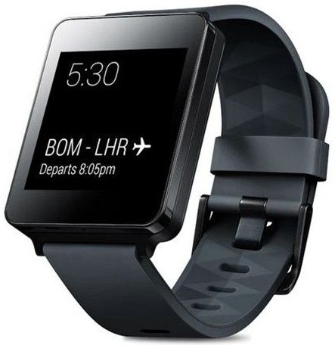
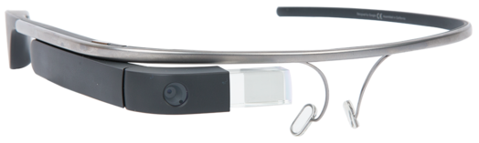
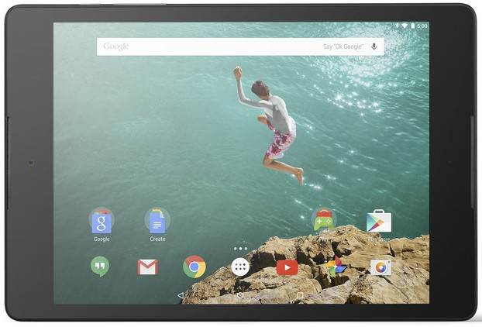
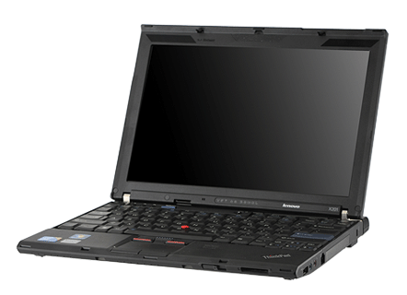
Operating systems are everywhere
42

Slide 43
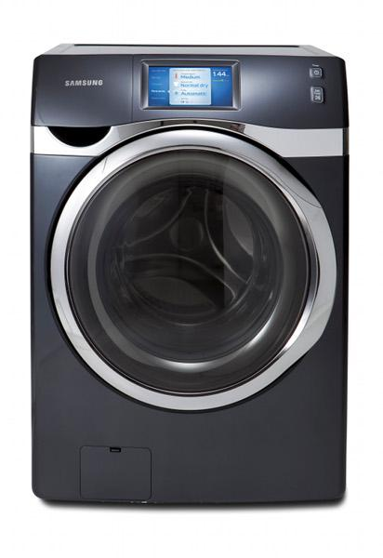
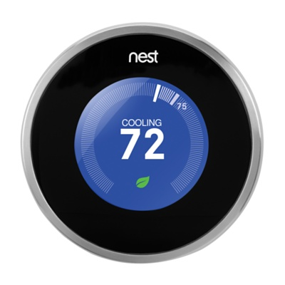
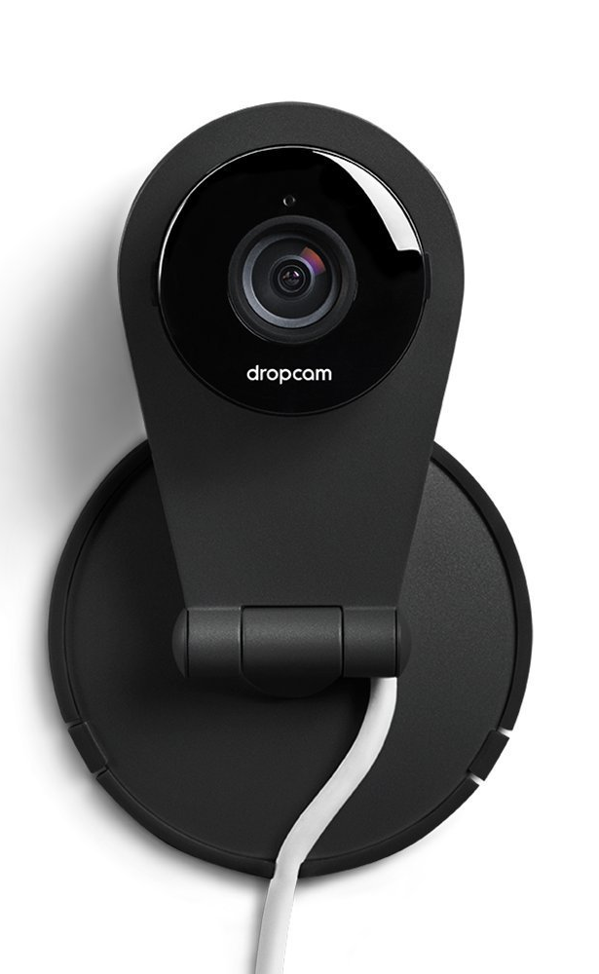
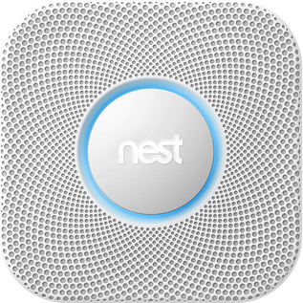
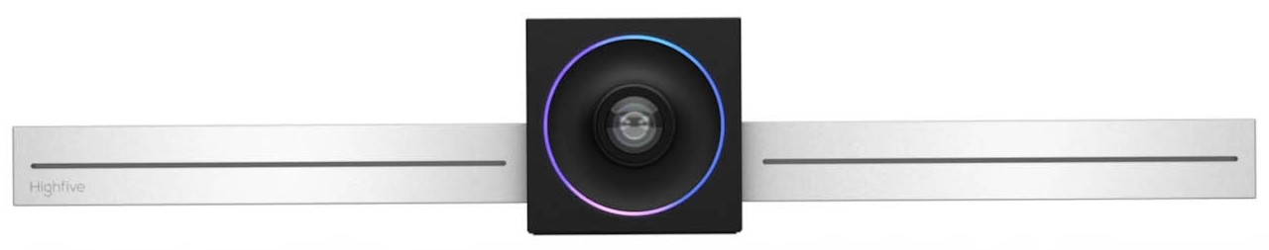
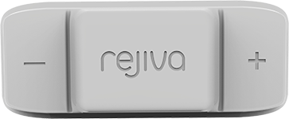

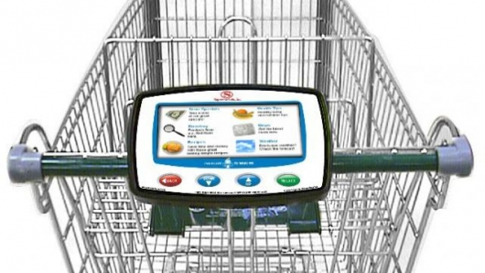
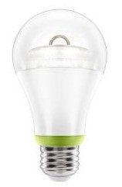

Operating systems are everywhere
43

Slide 44



Info-tainment!!

Slide 45
Summary of lecture
What is an operating system?
Early Operating Systems
Simple Batch Systems
Multiprogrammed Batch Systems
Time-sharing Systems
Personal Computer Systems
Parallel and Distributed Systems
Real-time Systems
Principles of Operating Systems - Lecture 1
45

Slide 46
Computer System & OS Structures
Computer System Organization
Operational Flow and hardware protection
System call and OS services
Storage architecture
OS organization
OS tasks
Virtual Machines
46

Slide 47

Computer System Organization
47

Slide 48
CPU execution
Addr 2³²-1
R0
…
R31
F0
…
F30
PC
…
Data1
Data0
Inst237
Inst236
…
Inst5
Inst4
Inst3
Inst2 Inst1
Inst0
Fetch
Exec
Execution sequence:
Fetch Instruction at PC
Decode
Execute (possibly using registers)
Write results to registers/mem
PC = Next Instruction(PC)
Repeat
PC
PC
PC
PC
Addr 0
From Berkeley OS course
48

Slide 49
Computer System Organization
I/O devices
49

Slide 50
I/O devices
I/O devices and the CPU execute concurrently.
Each device controller is in charge of a particular device type
Each device controller has a local buffer. I/O is from the device to local buffer of controller
CPU moves data from/to main memory to/from the local buffers
50

Slide 51

Interrupts
Interrupt transfers control to the interrupt service routine
Interrupt Service Routine: Segments of code that determine action to be taken for interrupt.
Determining the type of interrupt
Polling: same interrupt handler called for all interrupts, which then polls all devices to figure out the reason for the interrupt
Interrupt Vector Table: different interrupt handlers will be executed for different interrupts
51

Slide 52
Interrupt handling
OS preserves the state of the CPU
stores registers and the program counter (address of interrupted instruction).
What happens to a new interrupt when the CPU is handling one interrupt?
Incoming interrupts can be disabled while another interrupt is being processed. In this case, incoming interrupts may be lost or may be buffered until they can be delivered.
Incoming interrupts can be masked (i.e., ignored) by software.
Incoming interrupts are delivered, i.e., nested interrupts.
52

Slide 53
Direct Memory Access (DMA)
Typically used for I/O devices with a lot of data to transfer (in order to reduce load on CPU).
Device controller transfers blocks of data from buffer storage directly to main memory without CPU intervention.
Device controller interrupts CPU on completion of I/O
Only one interrupt is generated per block, rather than one per byte (or word).
Memory
CPU
I/O devices
I/O instructions
53

Slide 54
Process Abstraction
54

Slide 55
Process Abstraction
Process: an instance of a program, running with limited rights
55

Slide 56
Process Abstraction and rights
Process: an instance of a program, running with limited rights
Address space: set of rights of a process
Memory that the process can access
Other permissions the process has (e.g., which system calls it can make, what files it can access)
56

Slide 57
Hardware Protection
CPU Protection:
Dual Mode Operation
Timer interrupts
Memory Protection
I/O Protection
57

Slide 58
How to limit process rights?
58

Slide 59
Should a process be able to execute any instructions?
59

Slide 60
Should a process be able to execute any instructions?
No
Can alter system configuration
Can access unauthorized memory
Can access unauthorized I/O
etc.
How to prevent?
60

Slide 61
Dual-mode operation
Provide hardware support to differentiate between at least two modes of operation:
1. User mode -- execution done on behalf of a user.
2. Kernel mode (monitor/supervisor/system mode) -- execution done on behalf of operating system.
“Privileged” instructions are only executable in the kernel mode
Executing privileged instructions in the user mode “traps” into the kernel mode
Trap is a software generated interrupt caused either by an error or a user request
61

Slide 62
Dual-mode operation(cont.)
User
Mode bit added to computer hardware to indicate the current mode: kernel(0) or user(1).
When an interrupt or trap occurs, hardware switches to kernel mode.
Interrupt/
fault
Set
user
mode
Kernel
62

Slide 63
CPU Protection
How to prevent a process from executing indefinitely?
63

Slide 64
CPU Protection
Timer - interrupts computer after specified period to ensure that OS maintains control.
Timer is decremented every clock tick.
When timer reaches a value of 0, an interrupt occurs.
Timer is commonly used to implement time sharing.
Timer is also used to compute the current time.
Programming the timer can only be done in the kernel since it requires privileged instructions.
64

Slide 65
How to isolate memory access?
65

Slide 66

Process address space
Address space ⇒ the set of accessible addresses + state associated with them:
For a 32-bit processor there are 2³² = 4 billion addresses
What happens when you read or write to an address?
Perhaps Nothing
Perhaps acts like regular memory
Perhaps ignores writes
Perhaps causes I/O operation
(Memory-mapped I/O)
Perhaps causes exception (fault)
Process Address Space
(code)
66

Slide 67

Virtual Address
67

Slide 68
Providing the Illusion of Separate Address Spaces
Code
Data
Heap
Stack
Data 2
Code
Data
Heap
Stack
Stack 1
Heap 1
Code 1
Stack 2
Proc 1
Virtual
Address
Space 1
Data 1
Proc 2
Virtual
Address
Space 2
Heap 2
Code 2
kernel code
Load new Translation Map on Switch
Translation Map 1
kernel data
Translation Map 2
kernel heap &
Stacks
Physical Address Space
68

Slide 69

Address translation and memory protection
Processor
Virtual address
Translation
Invalid
Raise
Exception
Valid
Physical Memory
Data
Physical address
Data
69

Slide 70
Memory Protection
When a process is running, only memory in that process address space must be accessible.
When executing in kernel mode, the kernel has unrestricted access to all memory.
Must provide memory protection at least for the interrupt vector and the interrupt service routines.
70

Slide 71
Memory Protection: base and limit
0
To provide memory protection, add two registers that determine the range of legal addresses a program may address.
Base Register - holds smallest legal physical memory address.
Limit register - contains the size of the range.
Memory outside the defined range is protected.
Sometimes called Base and Bounds method
Base register
300040
300040
420940
120900
Limit register
1024000
71

Slide 72

Hardware Address Protection
The load instructions for the base and limit registers are privileged instructions.
72

Slide 73

Virtual Address translation using the Base and Bounds method
The load instructions for the base and limit registers are privileged instructions.
73

Slide 74
I/O Protection
All I/O instructions are privileged instructions.
Must ensure that a user program could never gain control of the computer in kernel mode, e.g., a user program must not be able to store a new address in the interrupt vector.
74

Slide 75
Question
Given the I/O instructions are privileged, how do users perform I/O?
75

Slide 76
Question
Given the I/O instructions are privileged, how do users perform I/O?
Via system calls - the method used by a process to request action by the operating system.
76

Slide 77

System Calls
User code can issue a syscall, which causes a trap
Kernel handles the syscall
77

Slide 78

System Calls
Interface between applications and the OS.
Application uses an assembly instruction to trap into the kernel
Some higher level languages provide wrappers for system calls (e.g., C)
System calls pass parameters between an and OS via registers or memory, memory tables or stack.
Linux has about 300 system calls
read(), write(), open(), close(), fork(), exec(), ioctl(),…..
78

Slide 79
System services or system programs
Convenient environment for program development and execution.
Command Interpreter (i.e., shell) - parses/executes other system programs
Window management
System libraries, e.g., libc
79

Slide 80
Command Interpreter System
Commands that are given to the operating system via command statements that execute
Process creation and deletion, I/O handling, secondary storage management, main memory Management, file system access, protection, networking, etc.
Obtains the next command and executes it.
Programs that read and interpret control statements also called -
Command-line interpreter, shell (in UNIX)
80

Slide 81
Storage Structure
Main memory - only large storage media that the CPU can access directly.
Secondary storage - has large nonvolatile storage capacity.
Magnetic disks - rigid metal or glass platters covered with magnetic recording material.
Disk surface is logically divided into tracks, subdivided into sectors.
Disk controller determines logical interaction between device and computer.
81

Slide 82
Storage Hierarchy
Storage systems are organized in a hierarchy based on
Speed
Cost
Volatility
Caching - process of copying information into faster storage system; main memory can be viewed as fast cache for secondary storage.
82

Slide 83

Storage Device Hierarchy
83

Slide 84
OS Task: Process Management
Process - fundamental concept in OS
Process is an instance of a program in execution.
Process needs resources - CPU time, memory, files/data and I/O devices.
OS is responsible for the following process management activities.
Process creation and deletion
Process suspension and resumption
Process synchronization and interprocess communication
Process interactions - deadlock detection, avoidance and correction
84

Slide 85
OS Task: Memory Management
Main Memory is an array of addressable words or bytes that is quickly accessible.
Main Memory is volatile.
OS is responsible for:
Allocate and deallocate memory to processes.
Managing multiple processes within memory - keep track of which parts of memory are used by which processes. Manage the sharing of memory between processes.
Determining which processes to load when memory becomes available.
85

Slide 86
OS Task: Secondary Storage and I/O Management
Since primary storage (i.e., main memory) is expensive and volatile, secondary storage is required for backup.
Disk is the primary form of secondary storage.
OS performs storage allocation, free-space management, etc. and disk scheduling.
I/O system in the OS consists of
Device driver interface that abstracts device details
Drivers for specific hardware devices
86

Slide 87
OS Task: File System Management
File is a collection of related information - represents programs and data.
OS is responsible for
File creation and deletion
Directory creation and deletion
Supporting primitives for file/directory manipulation.
Mapping files to disks (secondary storage).
Backup files on archival media (tapes).
87

Slide 88
OS Task: Protection and Security
Protection mechanisms control access of processes to user and system resources.
Protection mechanisms must:
Distinguish between authorized and unauthorized use.
Specify access controls to be imposed on use.
Provide mechanisms for enforcement of access control.
Security mechanisms provide trust in system and privacy
authentication, certification, encryption etc.
88

Slide 89
Operating Systems: How are they organized?
Simple
Only one or two levels of code
Layered
Lower levels independent of upper levels
Modular
Core kernel with Dynamically loadable modules
Microkernel
OS built from many user-level processes
89

Slide 90

OS Structure - Simple Approach
MS-DOS - provides a lot of functionality in little space.
Not divided into modules, Interfaces and levels of functionality are not well separated
90

Slide 91

Original UNIX System Structure
Limited structuring, has 2 separable parts
Systems programs
Kernel
everything below system call interface and above physical hardware.
Filesystem, CPU scheduling, memory management
91
Notes:
AIT NIST 041207
DRAFT of 04/03/07
91
DARPA12

Slide 92


Layered OS Structure
OS divided into number of layers - bottom layer is hardware, highest layer is the user interface.
Each layer uses functions and services of only lower-level layers.
THE Operating System and Linux Kernel has successive layers of abstraction.
92

Slide 93
Monolithic vs. Microkernel OS
Monolithic OSes have large kernels with a lot of components
Linux, Windows, Mac
Microkernels moves as much from the kernel into “user” space
Small core OS components running at kernel level
OS Services built from many independent user-level processes
Communication between modules with message passing
Benefits:
Easier to extend a microkernel
Easier to port OS to new architectures
More reliable and more secure (less code is running in kernel mode)
Fault Isolation (parts of kernel protected from other par
Detriments:
Performance overhead severe for naïve implementation
93

Slide 94

A microkernel OS
Slide adapted from http://web.cecs.pdx.edu/~walpole/class/cs533/fall2015/home.html
94

Slide 95
Virtual Machines
Physical Machine
Application
OS
Hardware
95

Slide 96
Virtual Machines
Virtual Machine 1
Virtual Machine 2
Virtual Machine 3
Application
Application
Application
OS
OS
OS
Virtual Machine Monitor (VMM) (aka Hypervisor)
Hardware
96
Notes:
servers commonly used in their times:
1981: VAX 11/782 minicomputer
1997: a workstation
2014: a rackmount server

Slide 97
Virtual Machines
Use cases
Resource configuration
Running multiple OSes, either the same or different OSes
Run existing OS binaries on different architecture
97
Notes:
http://www.gsmarena.com/samsung_galaxy_note_3-5665.php

Slide 98
Summary of Lecture set 1
What is an operating system?
Operating systems history
Computer system and operating system structure
98

